Slide 1
CINEBOOKDB
Cinema Ticket Booking System
Database Management Systems Project
GROUP
MODULE
SUPERVISED BY
DATE
Querycraft
DBMS
Mr. Karuna
15 June 2026
ICST University Park | HDIT Faculty of Computing and Technology

Slide 2
AGENDA
01
Introduction & Problem Statement
06
SQL Implementation & Queries
02
System Requirements & User Types
07
Testing & Security
03
System Architecture & Design
08
Performance & Challenges
04
ER Diagram & Relational Schema
09
Conclusion & Future Work
05
Normalization (UNF → 3NF)

Slide 3
INTRODUCTION
Problem Statement
CineBookDB is a relational database application to automate cinema ticket reservations, seat management, and payments.
Frequent double-bookings
Key DBMS Concepts Demonstrated:
Lost / fragmented customer records
ER Modelling
Relational Schema Design
Long queues, slow manual counter service
Normalization (UNF → 3NF)
Full SQL Implementation
Inability to generate timely sales reports
Testing & Security
CineBookDB solves all of the above with a normalised relational DB

Slide 4
SYSTEM REQUIREMENTS
Functional Requirements
FR-01
Customer Registration
FR-06
Seat Reservation (prevent double-booking)
FR-02
Movie Management
FR-07
Payment Processing
FR-03
Show Scheduling
FR-08
Booking Cancellation
FR-04
Seat Management (Standard / VIP / IMAX)
FR-09
Search & Filter
FR-05
Ticket Booking
FR-10
Sales Reporting

Slide 5
USER TYPES & NON-FUNCTIONAL REQUIREMENTS
User Types
Non-Functional Requirements
DB Administrator
Data Integrity
🛠
PK/FK constraints ensure relational consistency
Create tables, manage users, backups, optimise queries
Security
Cinema Manager
Role-based access & input validation
🎭
Schedule shows, manage movies, generate sales reports
Performance
Indexes on key columns for fast queries
Box Office Staff
Availability
🎟
Register customers, process bookings & cancellations
Continuous XAMPP/MySQL environment
Maintainability
Customer
3NF schema minimises redundancy
👤
Provide details, select shows, confirm bookings
Scalability
Supports new screens/movies without schema changes

Slide 6
SYSTEM ARCHITECTURE & DESIGN
Design Methodology
Presentation Layer
phpMyAdmin GUI
01 Requirement Gathering
02 ER Diagram Construction
Business Logic Layer
SQL Queries & Rules
03 Relational Schema Conversion
04 Normalization to 3NF
Data Layer
MySQL Database on XAMPP
05 MySQL Implementation
06 Testing & Validation
Tools: XAMPP 8.2 · MySQL 8.0 · phpMyAdmin 5.x · MySQL Workbench

Slide 7
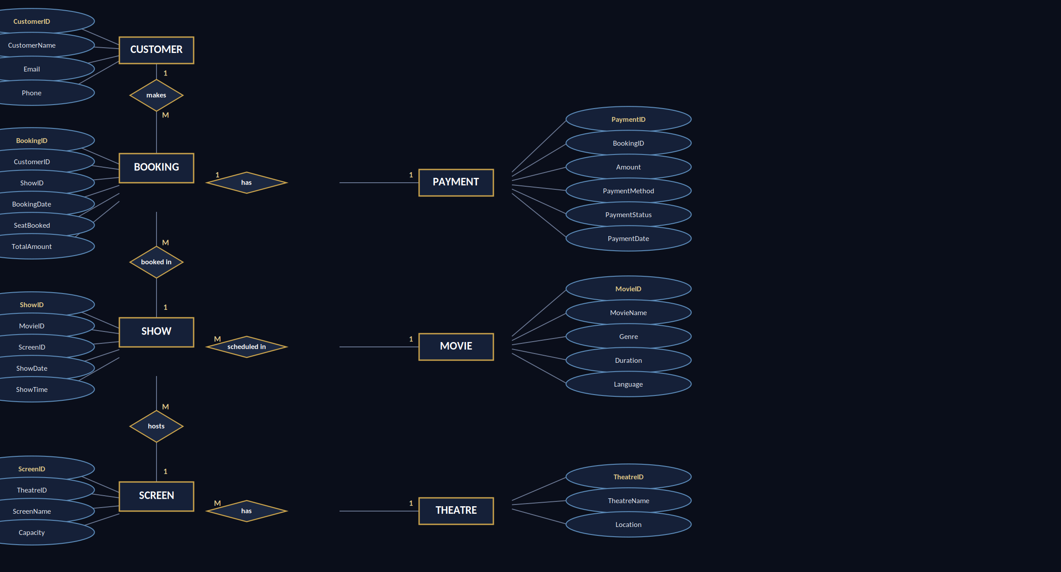
ER DIAGRAM & ENTITIES

Slide 8
RELATIONSHIPS & RELATIONAL SCHEMA
Entity Relationships
Schema Notation (3NF)
Customer → Booking
Customer(CustomerID [PK], FirstName, LastName, Email, Phone, Address, RegisterDate)
One-to-Many | A customer makes multiple bookings
Movie(MovieID [PK], Title, Genre, Duration, Rating, Language, ReleaseDate, Director)
Booking → Show
Many-to-One | Multiple bookings for one show
Show(ShowID [PK], MovieID [FK], ScreenID [FK], ShowDate, ShowTime, TicketPrice)
Movie → Show
One-to-Many | A movie has many show schedules
Seat(SeatID [PK], ScreenID [FK], SeatNumber, Row, Category, Price)
Booking ↔ Seat
Booking(BookingID [PK], CustomerID [FK], ShowID [FK], BookingDate, TotalSeats, Status)
Many-to-Many | Via BookingSeat junction table
Booking → Payment
BookingSeat(BookingSeatID [PK], BookingID [FK], SeatID [FK], ReservationStatus)
One-to-One | Each booking has one payment
Payment(PaymentID [PK], BookingID [FK], Amount, Method, Status, PaymentDate)

Slide 9
NORMALIZATION PROCESS
UNF
1NF
2NF
3NF
Unnormalized Form
First Normal Form
Second Normal Form
Third Normal Form
Flat single table with repeating seat groups (A1, A2, A3 in same row). No primary key defined. Mixed data with no structure.
Repeating seat columns removed. Each seat gets its own row. BookingID set as Primary Key. All attributes atomic.
Partial dependencies removed. Customer & Movie data moved to own tables. CustomerID/MovieID become Foreign Keys.
Transitive dependencies removed. Screen table created. All non-key attributes depend only on their primary key.
Final Result: 8 fully normalised 3NF tables — Customer, Movie, Screen, Show, Seat, Booking, BookingSeat, Payment

Slide 10
SQL IMPLEMENTATION
SELECT
Retrieve movie listings, customer records, booking details
INSERT
Add new customers, movies, shows, bookings, payments
UPDATE
Modify booking status, customer info, show schedules
DELETE
Remove cancelled bookings, obsolete shows, test data
INNER JOIN
Fetch complete booking details across multiple tables
LEFT JOIN
List all customers, including those with no bookings
GROUP BY
Total sales by movie, revenue by show date
ORDER BY
Sort customers alphabetically, bookings by date
Aggregate
COUNT, SUM, AVG, MAX, MIN — KPIs for management
Subqueries
Find highest-booking customer, above-average shows

Slide 11
TESTING & VALIDATION
12
10
2
83%
Test Cases
PASS
FAIL
Pass Rate
Key Test Cases
TC-ID
Description
Status
TC-01
Insert valid customer record
PASS
TC-02
Insert duplicate email → UNIQUE error
PASS
TC-03
Book available seat
PASS
TC-04
Book already reserved seat → constraint error
PASS
TC-06
Calculate total revenue (SUM aggregate)
PASS
TC-07
Cancel a booking → status updated
PASS
TC-09
LEFT JOIN — customers with no bookings
PASS
TC-10
GROUP BY revenue per movie
PASS
TC-11
ORDER BY booking date descending
FAIL
TC-12
Subquery — highest booking customer
FAIL

Slide 12
SECURITY & PERFORMANCE
Security Features
Performance Optimisation
🔒 Authentication
⚡ Indexing
MySQL user accounts with credentials
Indexes on CustomerID, ShowID, MovieID, BookingDate — faster JOIN & search
🔒 Authorisation
Role-based SELECT/INSERT/UPDATE/DELETE privileges
⚡ Query Optimisation
SELECT specific columns instead of SELECT * — less memory usage
🔒 Input Validation
NOT NULL, UNIQUE, CHECK constraints at schema level
⚡ 3NF Normalization
Eliminates update anomalies and reduces storage redundancy
🔒 Referential Integrity
FK constraints with ON DELETE RESTRICT
⚡ Redundancy Reduction
🔒 Data Backup
Customer/movie data stored once, referenced via FK
Regular .sql exports via phpMyAdmin
⚡ Data Types Review
🔒 SQL Injection Prevention
Parameterised queries + strict validation
INT for IDs, optimised VARCHAR lengths, DATE/TIME correctly typed

Slide 13
CHALLENGES & SOLUTIONS
⚠ Many-to-Many Relationship
⚠ Double Booking Prevention
✔ Introduced BookingSeat junction table with two foreign keys
✔ Added UNIQUE constraint on (ShowID, SeatID) in BookingSeat
⚠ Normalization Complexity
⚠ Foreign Key Errors
✔ Stepwise approach: UNF → 1NF → 2NF → 3NF with careful dependency analysis
✔ Populated parent tables first; used SET FOREIGN_KEY_CHECKS=0 during import
⚠ Query Performance
⚠ Booking Cancellation & Seat Release
✔ Added indexes on all primary and foreign key columns
✔ Implemented status field in BookingSeat; UPDATE triggered alongside booking cancellation

Slide 14
CONCLUSION
8 Tables
12 Tests
Fully normalised 3NF relational database
Structured test cases with 83% pass rate
10 Query Types
6 Security Features
SELECT, INSERT, UPDATE, DELETE, JOINs, GROUP BY, Subqueries
Auth, roles, constraints, FK integrity, backup, SQL injection
Future Work: Online payment gateway · Web front-end · Multi-branch support · Stored procedures & triggers

Slide 15
THANK YOU
CineBookDB — Cinema Ticket Booking System
Querycraft | DBMS Project | Academic Year 2025/2026
ICST University Park | Supervised by Mr. Karuna
Open for Questions

